Slide 1
Post-Market surveillance of Illumina products
Ivan Charkin, Jeff Leath, Alec Neff
MSDS 7330 project

Slide 2
Summary
In this project we collected the post-market data on the performance of products made by Illumina
The data were obtained from Twitter by custom Python script
The tweets were organized in a MongoDB database
NLP analysis of the data collected in the database was demonstrated

Slide 3
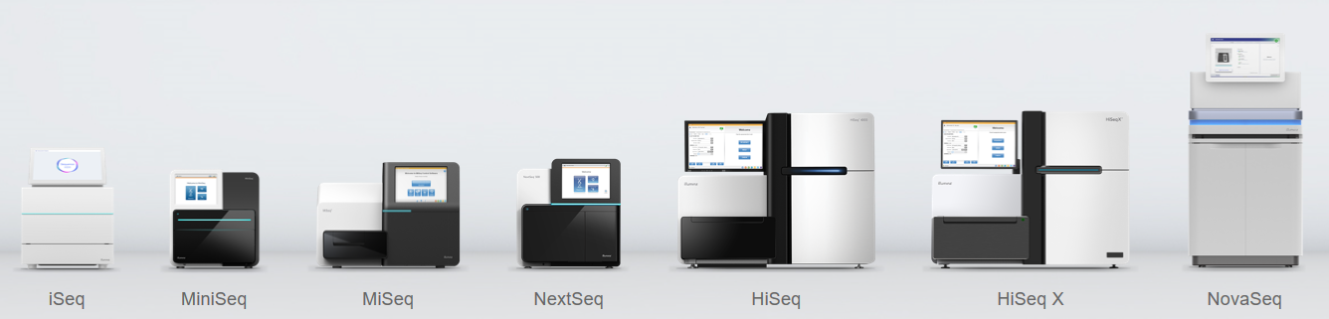
Illumina
Illumina is a leading company in the DNA sequencing market
It produces multiple platforms of DNA sequencers for various applications and consumables used for sequencing runs
The products are used for both research and medical diagnostics purposes (e.g. in-vitro diagnostics, cancer research)
www.illumina.com

Slide 4

Post-market surveillance
For on-market products it is generally a good practice to proactively seek customer feedback on the product performance instead of relying on complaints only
For medical devices proactive collection of data is required per Federal Regulations as part of post-market surveillance to identify any problems with the product
The data are supposed to be collected during the whole time the product is on the market

Slide 5
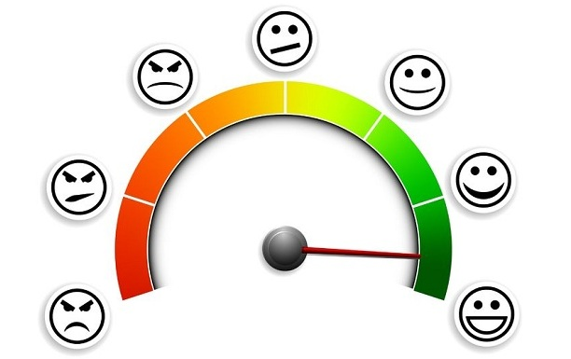
Examples of post-market data sources
Customer complaints – mostly reactive
Customer polls and questionnaires
Parts replacement data
Returns data
Clinical studies
Social media discussions – focus of this project

Slide 6

Data collection from social media
There are several specialized websites hosting discussion forums for specific applications of Illumina products, but the data access is limited
For this project we chose Twitter since there are already scraping libraries available
The length of each message is limited
There are already libraries available to make data gathering simpler

Slide 7
Twitter data collection
Python (“Tweepy”)
tweet mode=’extended’
(full text)
json.dumps(tweet. json) command
JSON Format
The following keywords were used in preliminary runs:
Illumina
MiSeq
MiniSeq
NextSeq
NovaSeq
iSeq
HiSeq

Slide 8
“Tweepy” return
['__class__', '__delattr__', '__dict__', '__dir__', '__doc__', '__eq__', '__format__', '__ge__', '__getattribute__', '__getstate__', '__gt__', '__hash__', '__init__', '__init_subclass__', '__le__', '__lt__', '__module__', '__ne__', '__new__', '__reduce__', '__reduce_ex__', '__repr__', '__setattr__', '__sizeof__', '__str__', '__subclasshook__', '__weakref__', '_api', '_json', 'author', 'contributors', 'coordinates', 'created_at', 'destroy', 'entities', 'favorite', 'favorite_count', 'favorited', 'geo', 'id', 'id_str', 'in_reply_to_screen_name', 'in_reply_to_status_id', 'in_reply_to_status_id_str', 'in_reply_to_user_id', 'in_reply_to_user_id_str', 'is_quote_status', 'lang', 'parse', 'parse_list', 'place', 'possibly_sensitive', 'retweet', 'retweet_count', 'retweeted', 'retweets', 'source', 'source_url', 'text', 'truncated', 'user']
_json - JSON serializable response data as a dictionary
json.dumps extracts the data in JSON format

Slide 9
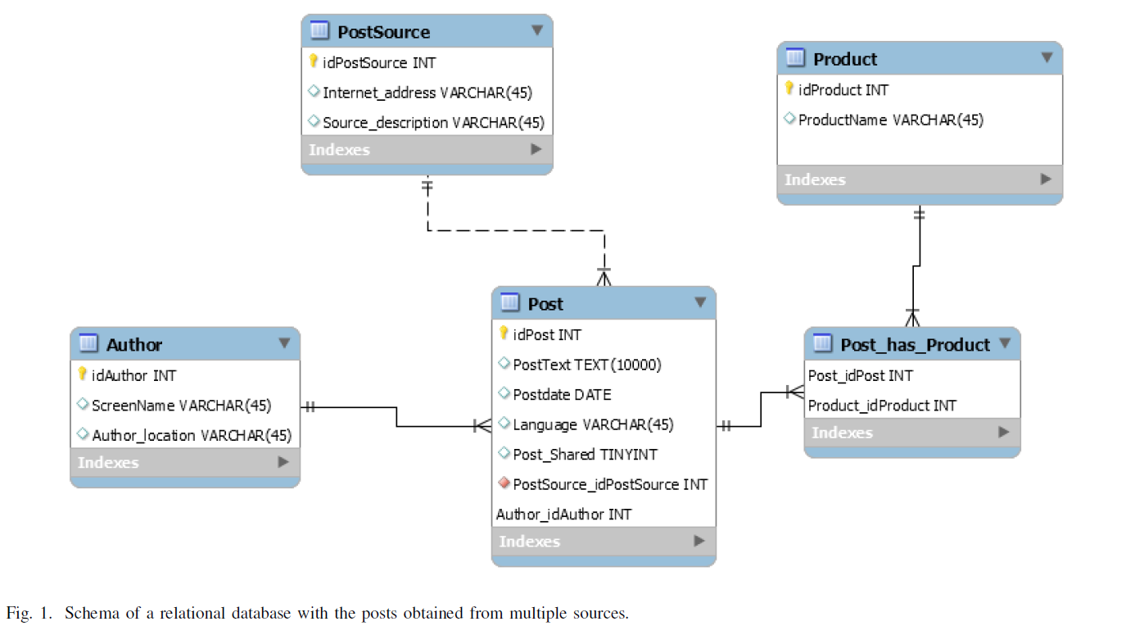
Database plan
Initial Plan
SQL

Slide 10
Database plan
Initial Plan
SQL

Slide 11
Database plan
Final Plan
MongoDB
Collection = “Illumina”
“mongoexport”
“upsert” function to append new records

Slide 12
Natural language processing
Queried MongoDB with Python
”full text” field for specific keywords
TextBlob ”translate” function
automatically detects the source language and translates

Slide 13
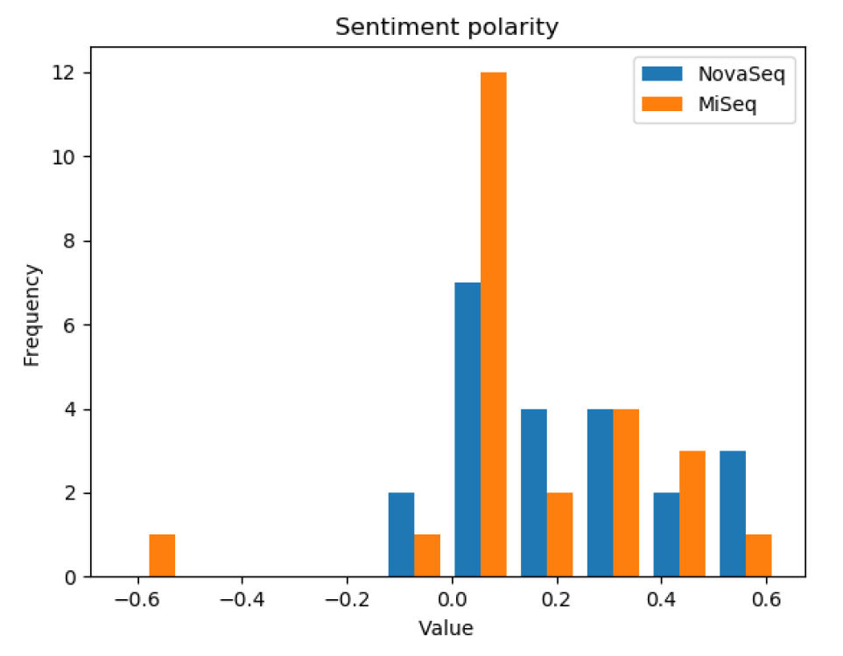


Natural language processing Sentiment Analysis

Slide 14
Natural Language Processing Sentiment Analysis “Pitfalls”!
”Just shy of 4 TeraBases for our S4 NovaSeq run. That is seriously mad!”
-Score very low
-Reality very positive

Slide 15
Conclusions
Unstructured data scrapped from internet
Created scalable database
Utilized DB for value added activity

Slide 16
Questions?

